Slide 1
Design, Development, and Evaluation of a Novel Device for Visualization of Volumetric Medical Images Paria Alipour¹, Bryan Palogan², Leslie Simms², Sumit Laha³, Hossein Dehghani², Ulas Bagci³ and Sang-Eun Song¹ ¹ Department of Biology, University of Central Florida ²Department of Mechanical and Aerospace Engineering University of Central Florida, Orlando, FL, USA ³Department of computer engineering University of Central Florida

Slide 2
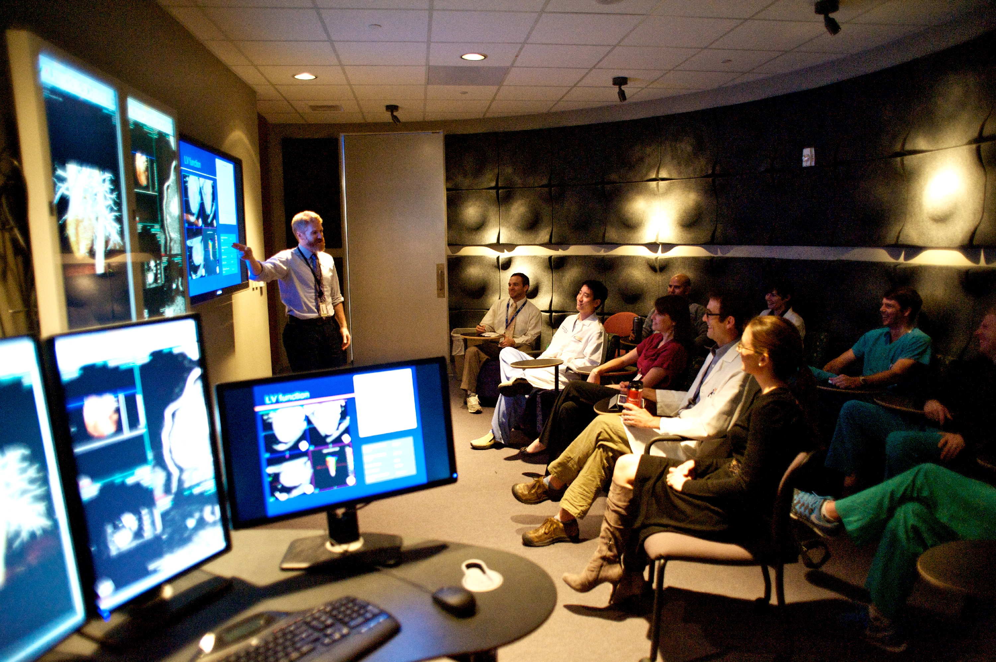
Introduction
Essential Role of medical image visualization
Education
Diagnose

Slide 3
Contents
Existing technologies for visualization of medical images
Materials
Methods
Results
Future Work

Slide 4
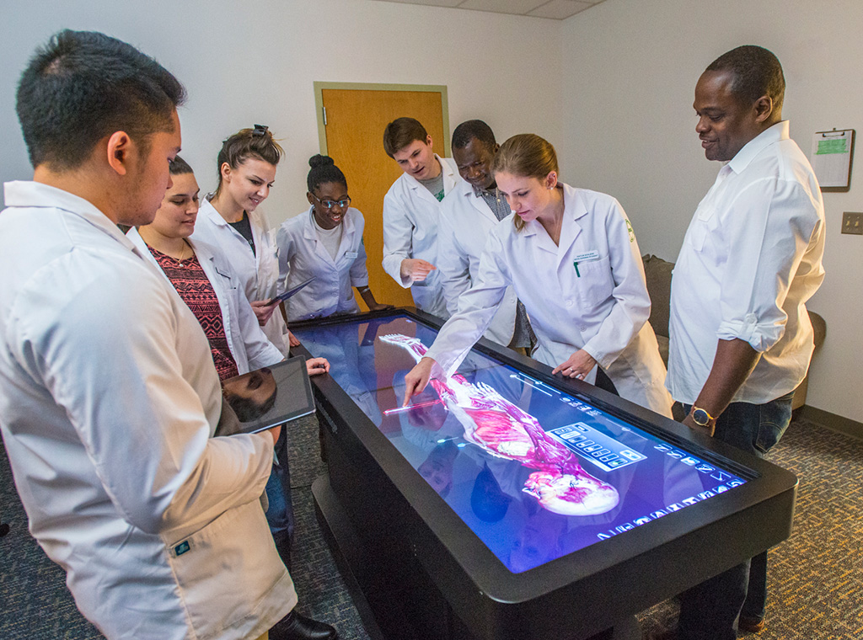
Existing technology for visualization of medical images
Anatomage
Notes:
Before we mentioned that it wasn’t used for radiology, but the system has been updated and can display DICOM images now. The price is still a major drawback for this system, as well as its size.

Slide 5
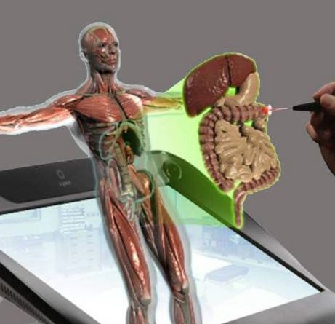
Existing technology for visualization of medical images
Echopixel
Notes:
Allows the user to interact with the body through a stylus and a pair of 3D glasses. It uses its own specialized software, unlike the Air Slicer, which uses the program 3DSlicer, which is free program that many doctors are accustomed to.

Slide 6
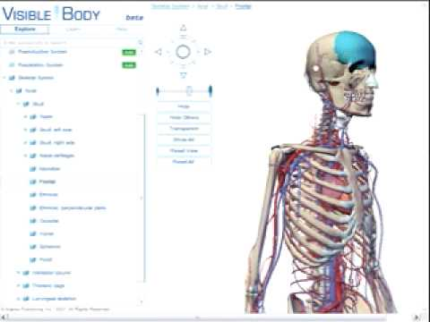
Existing technology for visualization of medical images
VisibleBody
Notes:
Projects virtual body onto a surface. Used for mobile devices but can only display pre-modeled bodies. This means that radiologists have no use for it, but it is a very powerful tool to use for education.

Slide 7
Design Goals
Virtual slicing of medical images with realistic spatial operation.
View an anatomical target from any angle.
Develop an easy-to-use device for 3D visualization of volumetric medical images.

Slide 8
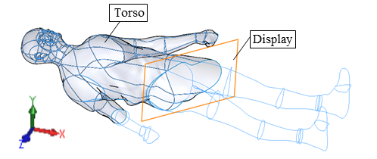
Material Working principle
Design requirement
1) Operational workspace
2) Maneuverability
3) Localization

Slide 9
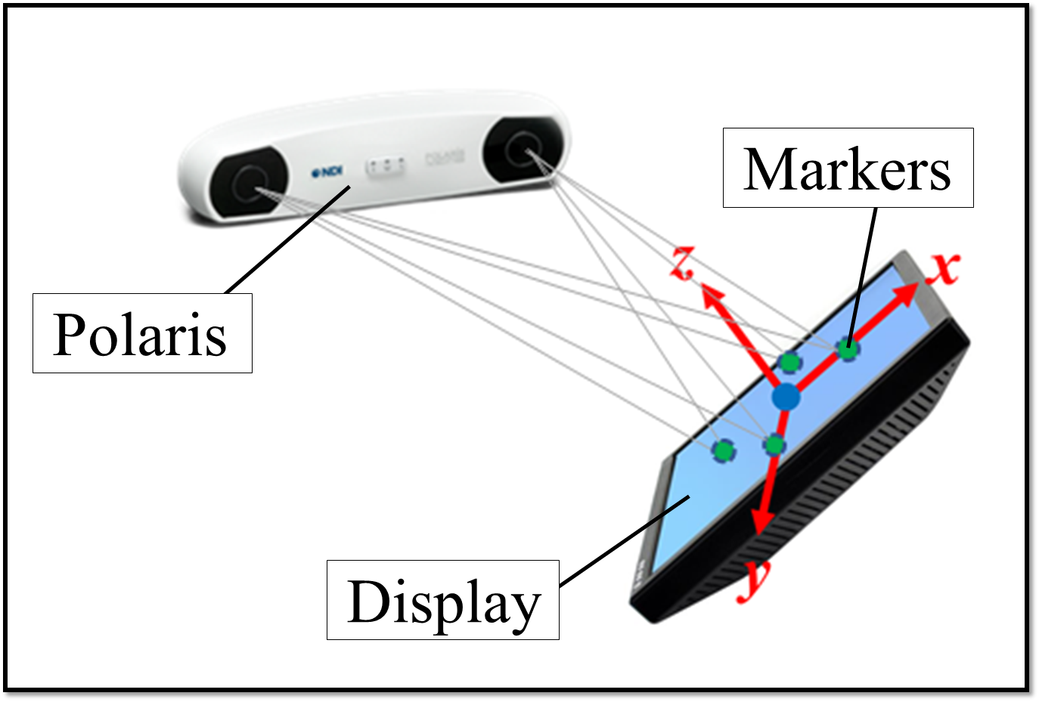
Material
System components
1) A motion tracking system (Polaris)
2) Tablet (iPad or Microsoft Surface)
3) Graphical User Interface

Slide 10
Material
Software architecture
1) Insight Segmentation & Registration Toolkit (ITK)
2) Visualization Toolkit (VTK)
Notes:
**Not sure if you should make this a key point.** Not entirely sure on the details for these things. (Left Image: System overview: the components of initialization and run-time.) (Right Image: The exchange of data between physical world and software.)

Slide 11
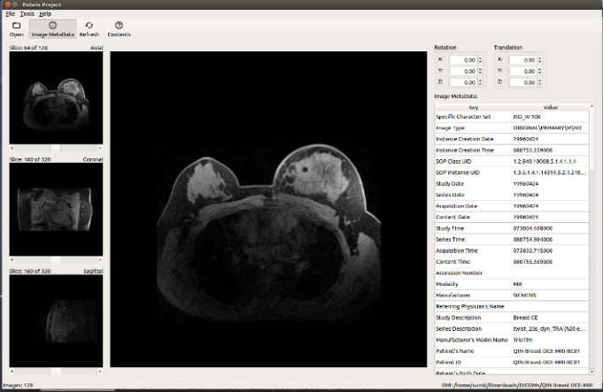
Results
System displays cross sections accurately within the workspace
Notes:
Current results are that the system successfully displays the appropriate image based on the position of the tablet

Slide 12
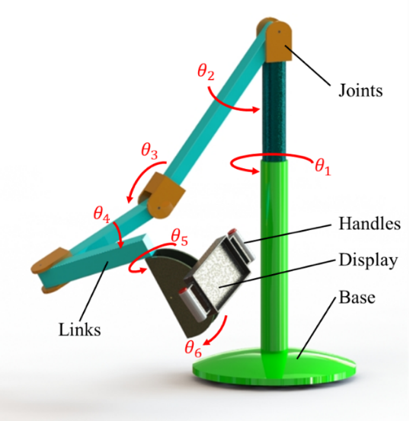
Future Work
Replace the Polaris with an encoded arm
Notes:
Talk about the limitations of the current design. When the Polaris didn’t have a clear line of sight to the markers on the back, the position of the tablet can’t be determined and images cannot be updated. The arm fixes this because potentiometers can determine the position without the issue of a blind spot that the current system has.

Slide 13
Conclusion

Slide 14
Q&A, Comments?
Design, Development, and Evaluation of a Novel Device for Visualization of Volumetric Medical Images
University of Central Florida
Interventional Robotics Lab

