Slide 1


Yoav Peles
Chair Re-Appointment,
Mechanical and Aerospace Engineering (MAE),
College of Engineering and Computer Science (CECS),
University of Central Florida (UCF)

Slide 2
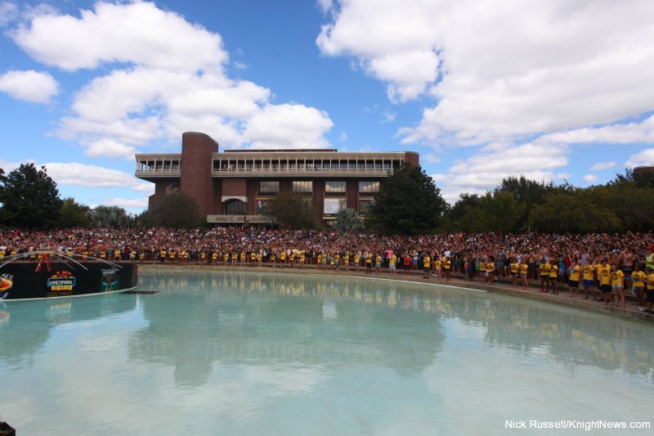
Reflection on the last five years

Slide 3

Disclaimer
The slides in this presentation are the result of the extremely dedicated and talented faculty and staff members of the MAE department, with the support of the college. They collectively reflect the success of the department, not that of an individual

Slide 4
By the numbers
 | 2015 | 2019 | Multiplier
Resources
Faculty headcount | 30 | 44 | ×1.5
Full-time staff headcount | 11 | 11 | ×1.0
Operation budget | $268,419 (FY 15) | $230,225 (FY 19) | ×0.83
GTA/ORC fellowship | ~37 | 59 | ×1.6
Outcomes
PhD enrollment | 80 | 145 | ×1.8
PhD graduation rate | 11 | 18 | ×1.6
UG enrollment | 2,732 | 3,876 | ×1.42
G enrollment | 188 | 383 | ×2
Research expenditure | $3.2M | $6.6M (AY19) | ×2
PhD programs | 1 | 2 | ×2
MS programs | 2 | 3 | ×1.5
Capstone funding | ~$0 | ~$300k | ×∞
US and & report Ranking | 103 | 65 | ×0.65
Take home message: ×1.4- 2 outcomes; Resources: ×0.83-1.6

Slide 5

Graduate program
Key players: Jihua (Jan) Gou, Seetha Raghavan, Jeffery Kauffman, and Alain Kassab
PhD applicants
  From 76 (2015) to 247 (2019)
  PhD acceptance rate:
    2015: 71.5%
    2019: 27.1%
PhD degrees awarded
  From an average of 5-6 before AY15 to 18 in AY19
    AY15: 80/5.5=14.5 years
    AY19: 145/18=8 years
  AY20 is projected to be another record year
New graduate programs
  PhD Aerospace
  MS bio-medical engineering
  Online tracks in MSME and MSAE
35 new doctoral students every year
  OR fellowships (20-25 a year for the last four years)
  GTAs
  GRAs
  Other fellowships (e.g., NSF, Fulbright)
Major emphasis on recruitment
  Stories and ads in various media outlets (Study International), Webinars with prospective graduate students, target list to international colleagues, etc.

Slide 6
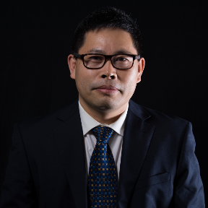
Graduate enrollment data
Courtesy of Dr. Jan Gou

Slide 7
PhD applications
Applied 2019/Applied 2015=3.25
Accepted 2019/Accepted 2015=1.2
Enrolled 2019/Enrolled 2015= 2.6
Courtesy of Dr. Jan Gou

Slide 8
PhD degrees awarded
Data courtesy of Mr. Kamryn Lamons.

Slide 9
Research expenditure

Slide 10
Major contracts and grants
Million⁺ dollar
Young investigator
Agencies
Helen Huang
Subith Vasu
Kareem Ahmed
Jay Kapat
Quanfang Chen
Shawn Putnam
Subith Vasu
Kareem Ahmed
Robert Steward
DoD
DoE
NIH
DARPA
DTRA
ONR
ARPA-e
NASA
NSF
Industry

Slide 11
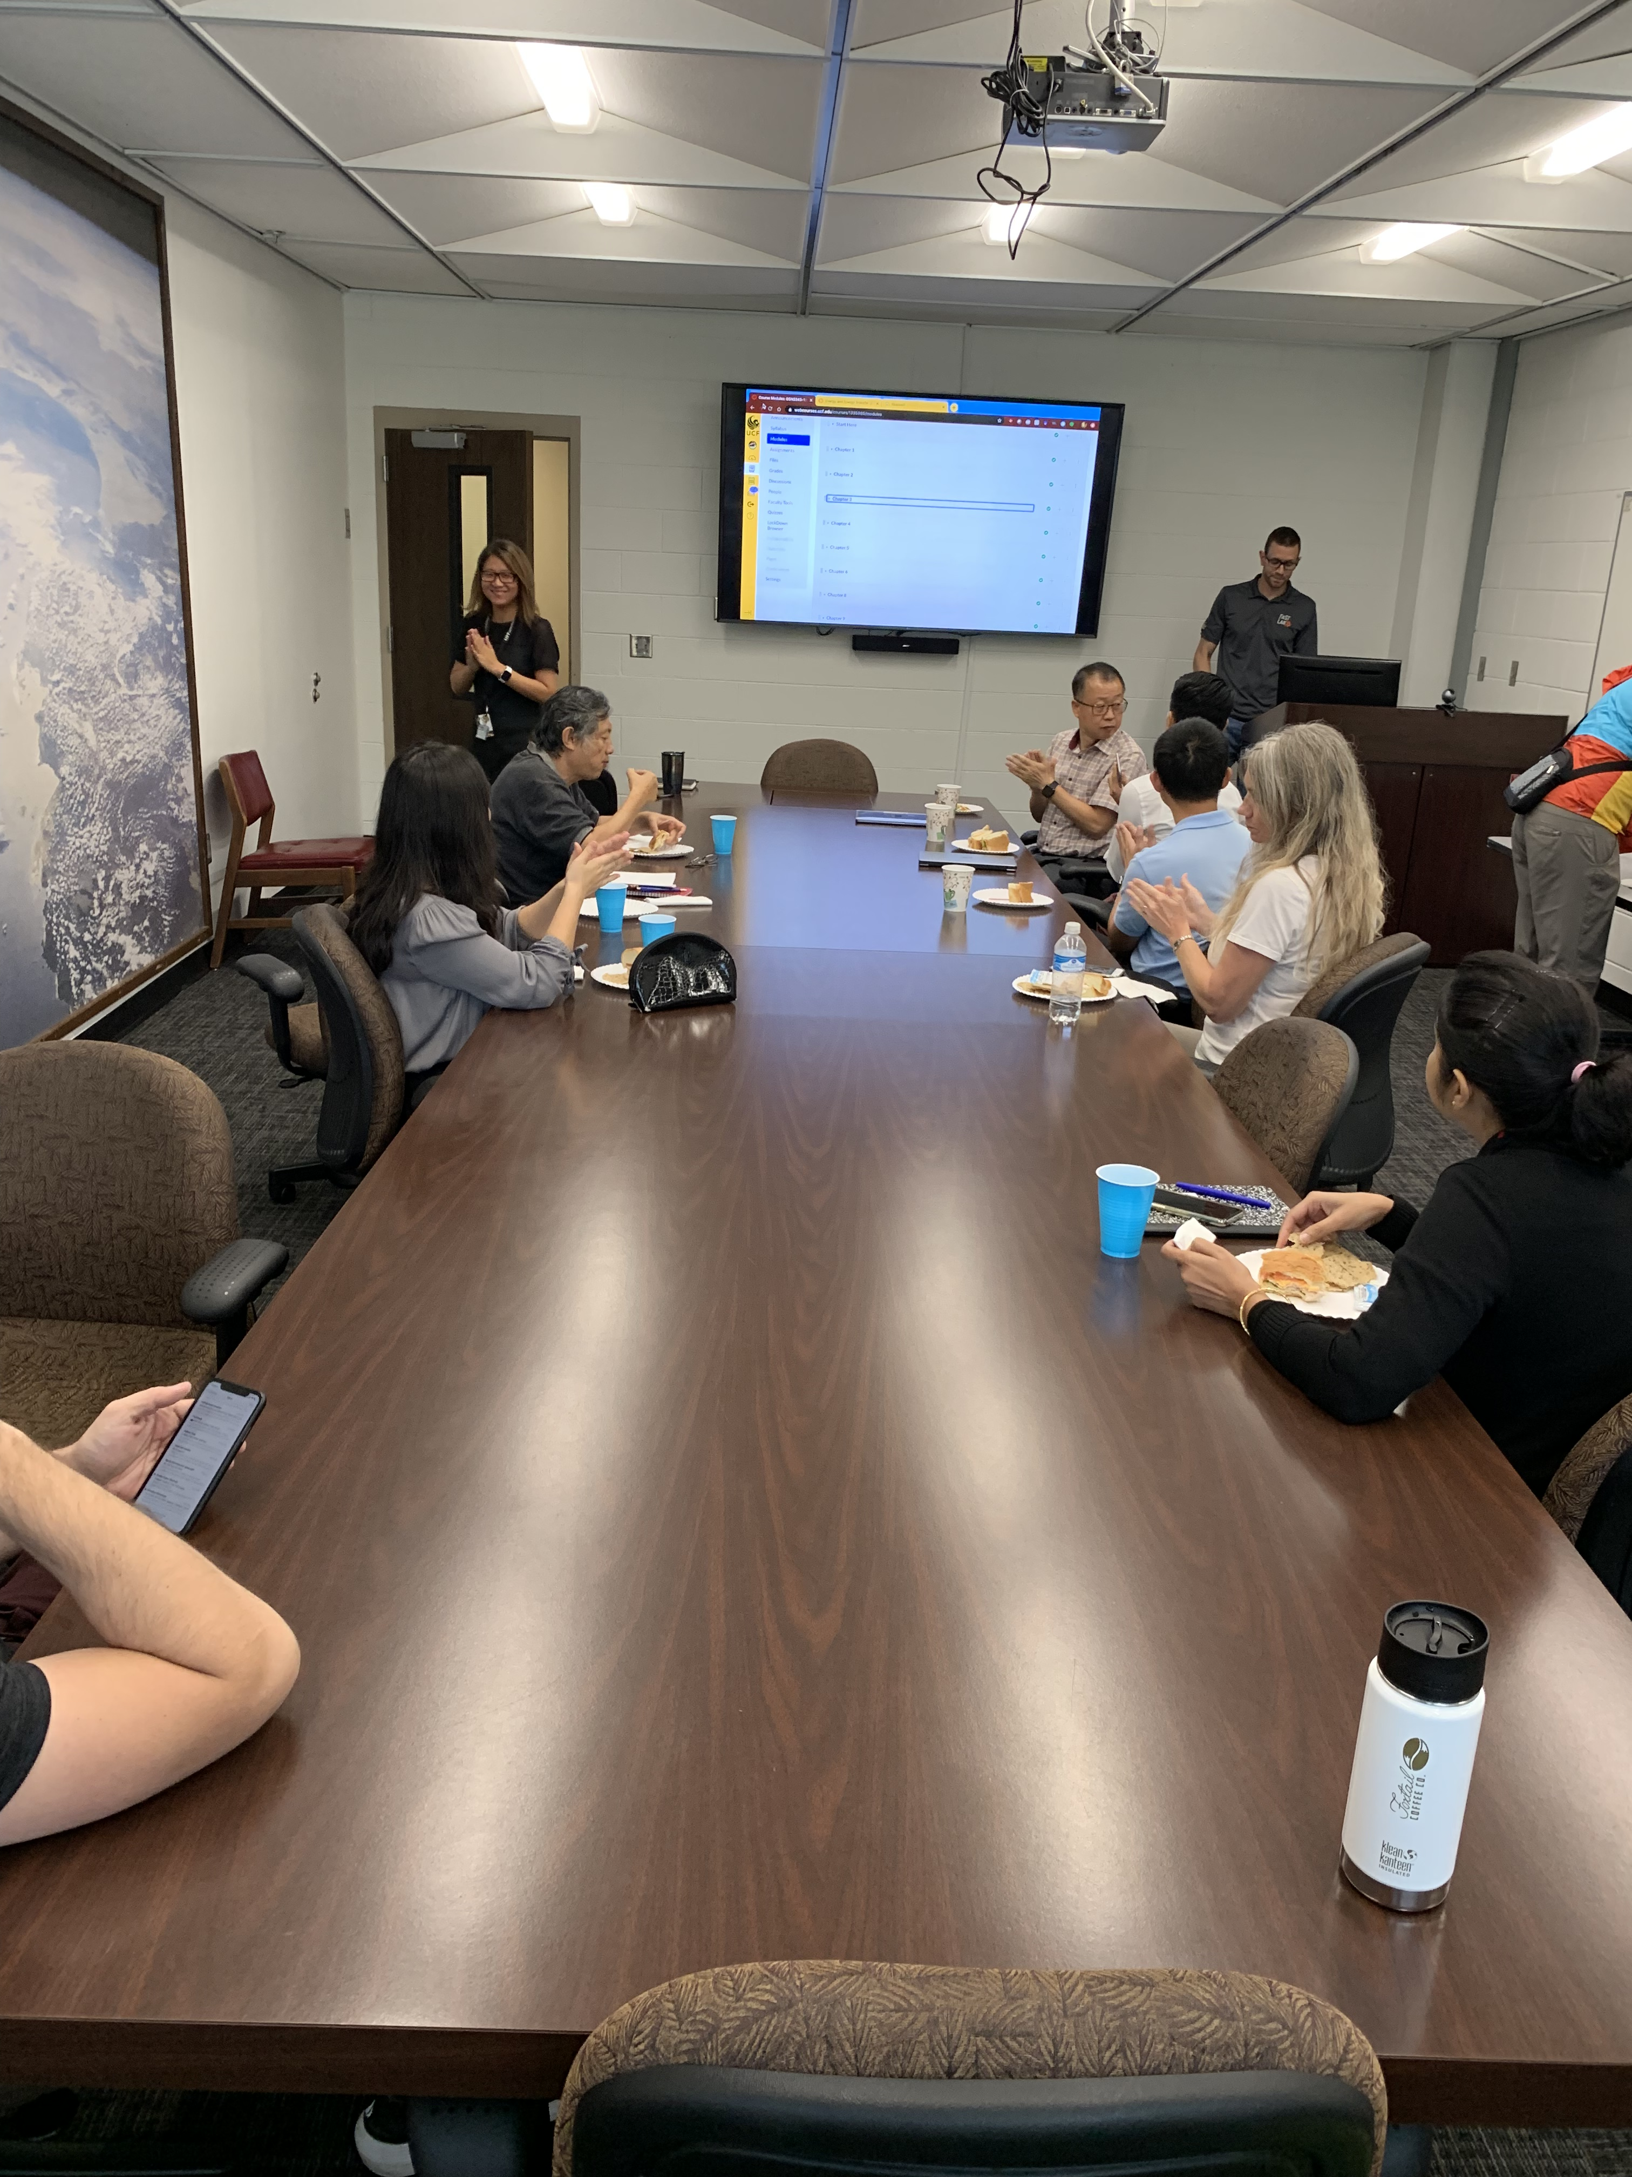
Undergraduate
Streamlined courses
  Consolidated sections
  Eliminated service courses
Leveraged technology
SoTL
  Nader (Course redesign initiatives, educational proposals)
  Tian (Engineering education papers)
  Pal (NIH educational grant)
  Steiner (Engineering education papers — capstone design)
  Stresau (Engineering education papers — capstone design)
Active learning workshop
Machine shop
Project based learning
Programing

Slide 12
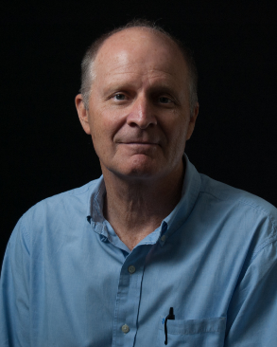
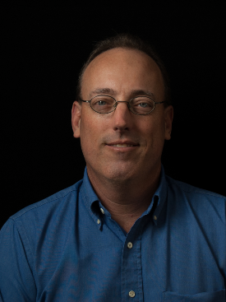
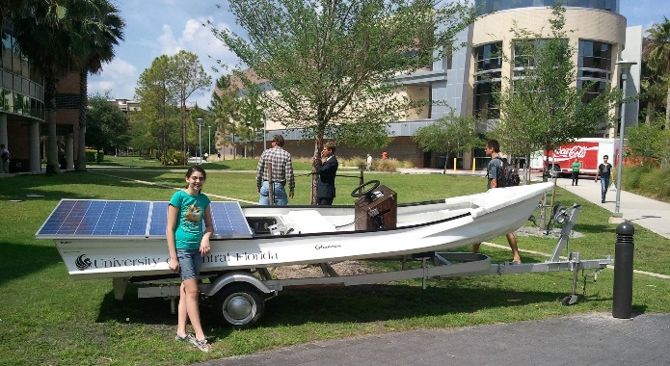
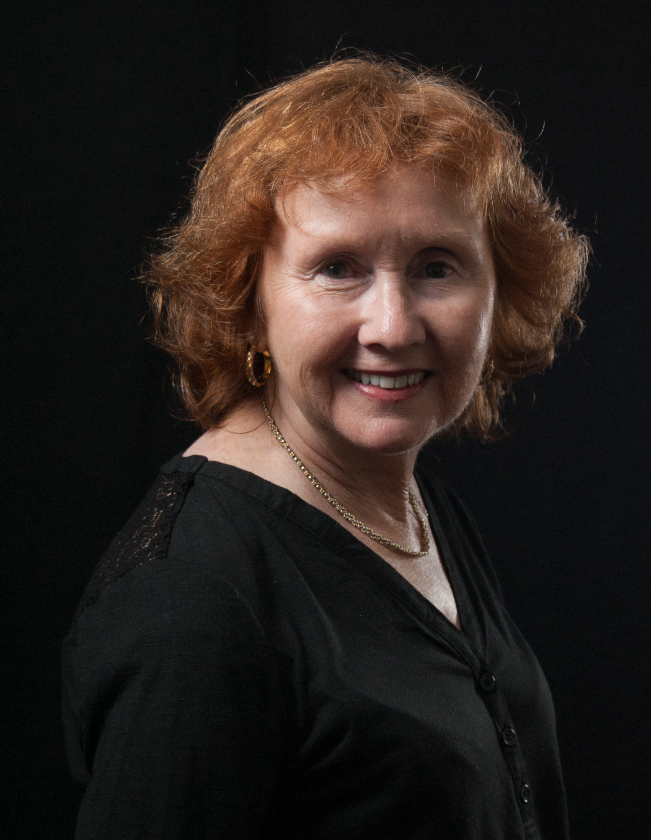
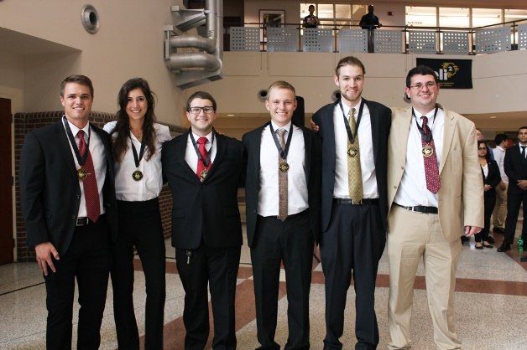
Capstone (I-Design) design Program
Personnel:
  Director: Mark Steiner
  Coordinator: Kurt Stresau
  Support staff: Ms. Paula Miller
Establishment of a new capstone paradigm in the department and college
  Sponsored based projects
  Mainly mentored by experienced engineers from industry
  Multidisciplinary design teams
  Onboarding other department into the program
Redesign of the course
  Six design milestones
  Streamline expectations
  Better mentorship of faculty and adjuncts
  Consistency
  Better alignment with ABET requirements
Transition to interdisciplinary teams

Slide 13
I-Design Program Funding
On average ~150 students per semester (~300 annually) participated on I-Design Program sponsored projects

Slide 14
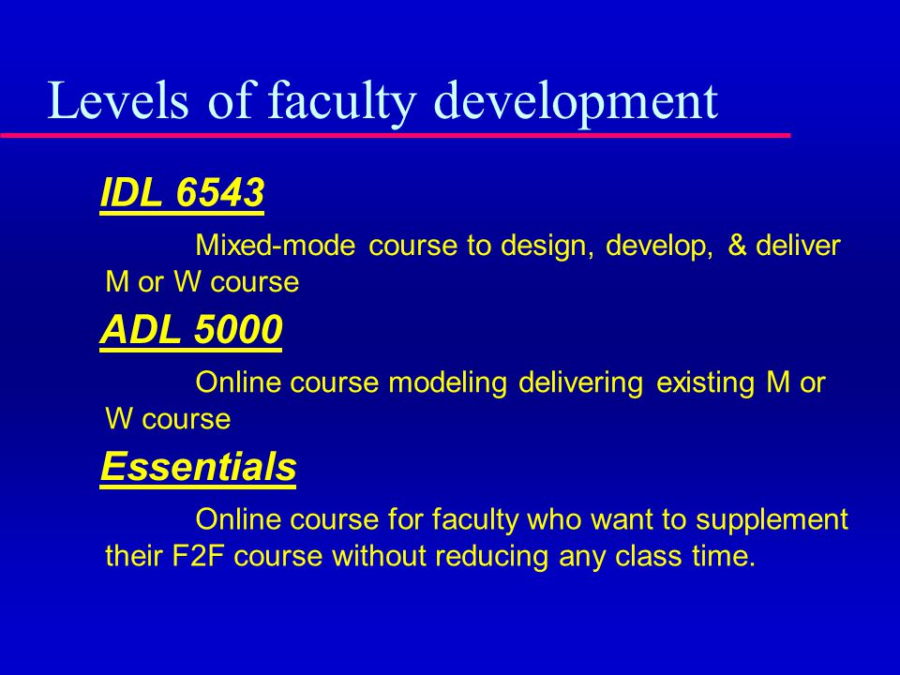
IDL 6543
Completed/currently taking
Scheduled to take
Tuhin Das
Yunjun Xu
Olusegun Ilegbusi
Yoav Peles
Helen Huang
Yuanli Bai
Tian Tian
Marino Nader
Andrew Dickerson
Shawn Putnam
Sagnik Mazumdar
Sudeshna Pal
Ahmet Ozbay
Kurt Stresau
Mark Steiner
Mike Kinzel
Tarek Elgohary
Samik Bhattacharya
Jeon-Hyuk Park
Jan Gou
20 MAE faculty members will be certified to teach mixed mode by the end of this academic year.

Slide 15

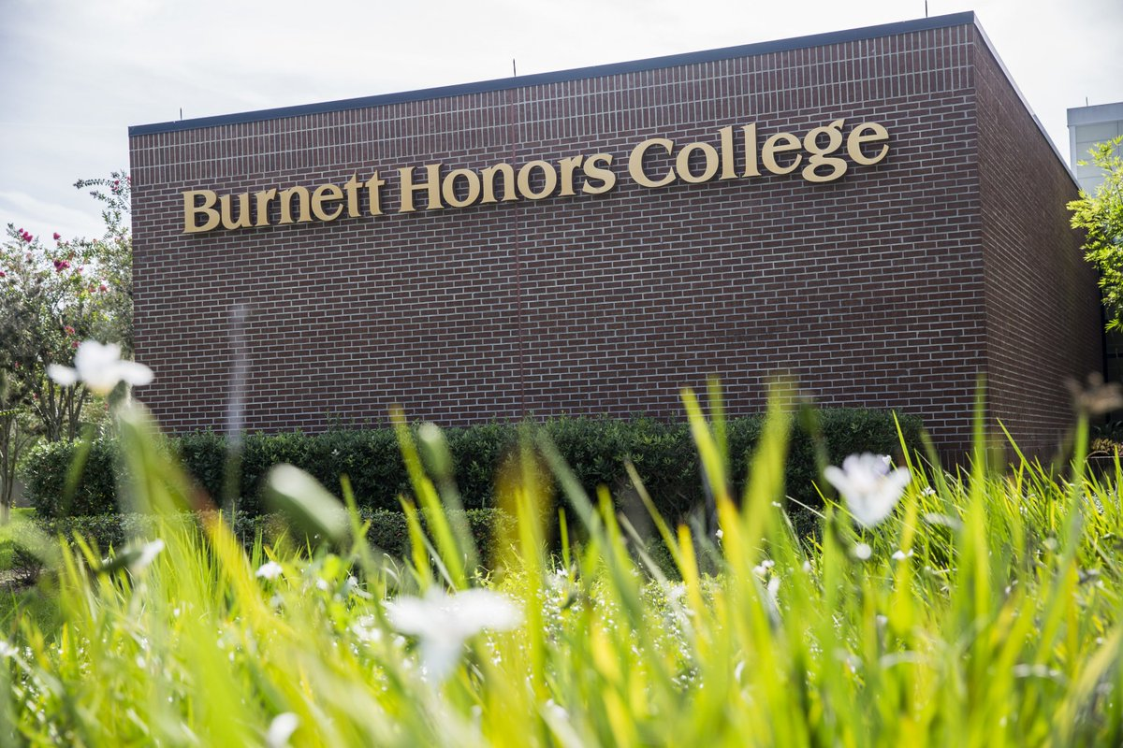
Honors and mixed-mode course trends
Mixed-mode
Honors

Slide 16





Early career faculty
Hired 16 new outstanding tenure track faculty members
  Broad search
  Cluster (×3)
  Bio-medical engineering (×2)
Reduced teaching load
  One course per semester per year
CAREER mentorship
ORC fellowships
Open door policy
One-on-one meetings
Proposals — input and review
  Publications — input and guidance
  Graduate student mentorships
  Teaching — strategy and feedback
  Help network
Lab space
  From day one
Successfully led major research proposals
  Kareem Ahmed (DOE, US Army)
  Subith Vasu (DOE, DARPA, DTRA)
  Helen Huang (NIH R01)
  Robert Steward (NIH K25)
  Shawn Putnam (NSF CAREER)

Slide 17


Lecturers/Instructors
Hired five new outstanding and dedicated lecturers and an instructor
  Four replacement
  One new position
Committed to teaching and SoTL
  Engineering education research
  Leveraging technology in the class room
  Leading college wide and university wide activities

Slide 18
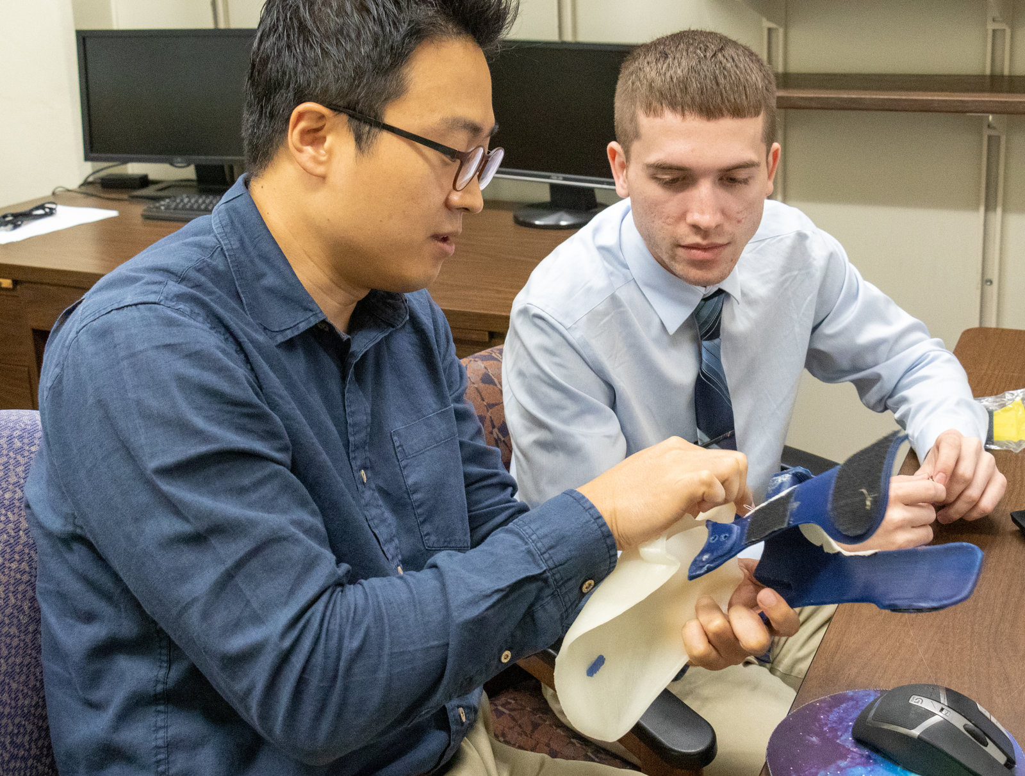
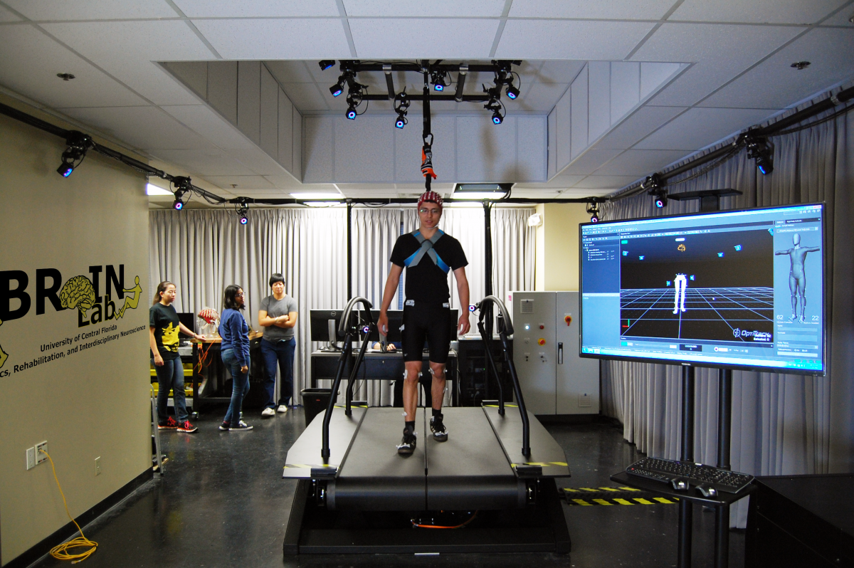
Bio-medical engineering
Lead: Alain Kassab
Faculty count (2019): 11
Faculty count (2015): 4
Biionix Cluster
  Two new hires
  Affiliated faculty members
DAT cluster
  1 new faculty member
Bio-medical engineering hires (7 total)
  Bio-medical engineering
    Helen Huang
    Sam Song
  Biionix cluster
    Qiushi Fu
    Hwan Choi
  Lecturer
    Sudeshna Pal
  Broad search
    Andrew Dickerson
    Luigi Perotti
Master degree in bio-medical engineering
Proposal to establish a PhD program
Stronger relation with College of Medicine

Slide 19
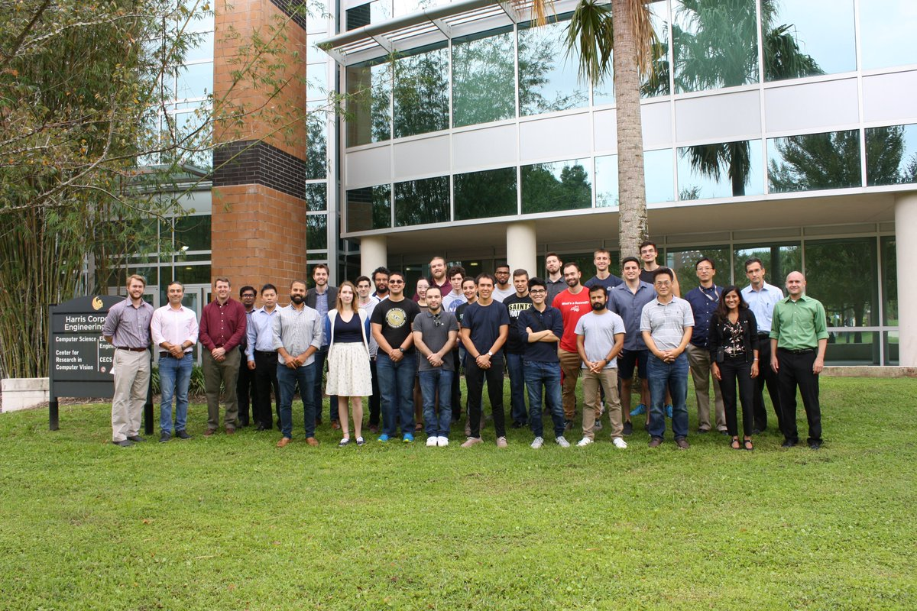
Aerospace Engineering
A quote from McBrayer [1]: “The process for the implementation of the Ph.D. program in Aerospace Engineering is in place, with anticipated degree granting status in 2005.”
Lead: Seetha Raghavan and Jeff Kauffman
Faculty count (2019): 15
Faculty count (2014): 8
A new PhD program
First cohort: 33
Separate capstone design projects
[1] J.D. McBrayer, Chapter 54, Aerospace Education at the University of Central Florida, from Aerospace Engineering Education During the First Century of Flight, AIAA, pp. 692-699, 2004.

Slide 20
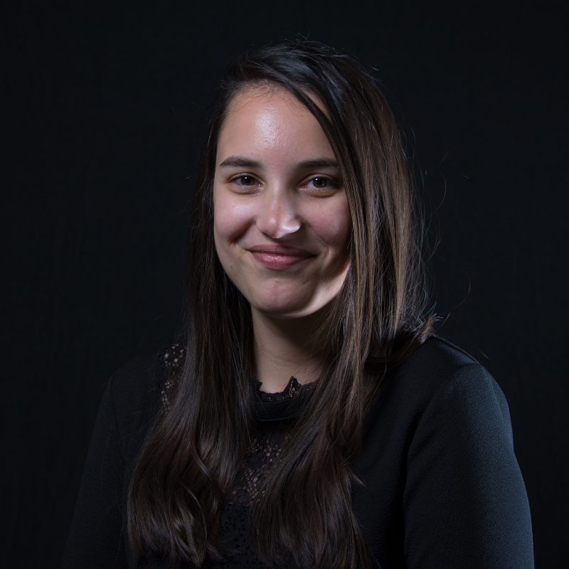

Communications
An effort that started in Fall 2016
  Paul Kelly (departed March 2018)
  Marisa Ramiccio
Communicate MAE’s successes to our constituents and colleagues
  Students
  Faculty and staff
  Prospective graduate students
  Alumni
  Department chairs
Magazine
Newsletters
Flyers
Revamp website
Department chairs
Graduate requirement

Slide 21



Department visibility
Engage with the ASME ME Department Heads/Chairs’ Executive Committee (MEDHEC)
Encourage faculty to give presentations and interact with their respective communities
Invite leaders to campus
  MAE’s seminar series,
  Support on-campus international/national workshops
    5th Int. Conf. on Eng. Frontiers in Pediatric and Congenital Heart Disease (2016, Alain Kassab)
    Workshop on Highly Turbulent Combustion (2018, Kareem Ahmed)
    More workshops in the spring of 2020
Press
  Andrew Dickerson (The New York Times)
  Kareem Ahmed (Channel 6)
  Subith Vasu (Orlando Sentinel)
ASME EFx (ASME student organization )

Slide 22
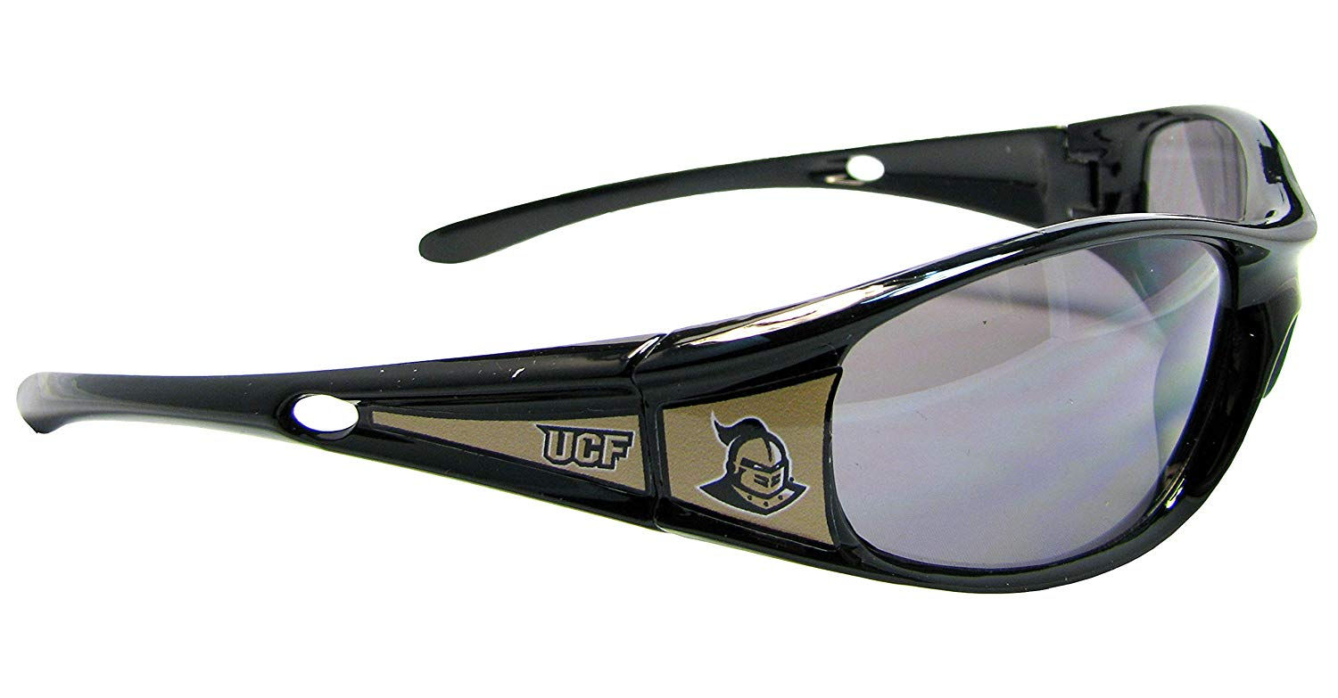
Vision for the next five years

Slide 23

Vision
Continue to enhance national and international standing as a premier research department
Improve the quality and effectiveness of the undergraduate program and produce better, more prepared and sought-after engineers
Better align MAE’s curriculum with industry needs
Establish a vibrant and joyful research and educational community that supports and celebrates success
Become a global magnet for domestic and international students and scholars from diverse backgrounds, cultures, demographic groups, and genders

Slide 24

Goals
Research prominence
  Graduate program
  Support for PhD students
  Centers of excellence
    CATER
    Clusters
      Biionix
      DAT
  Graduate courses
  Faculty hires
  Staff retention and support
  Mentorship and support of junior faculty members
Undergraduate program
  Technology
    Adaptive learning
    Mixed-mode
  Interdisciplinary (I) design program (a.k.a., senior design)
  Honors courses
  Advanced Manufacturing concentration

Slide 25

Research prominence —graduate program
Quality and quantity of the graduate student population, mostly PhD students
Recruit, retain, and cater to exceptional graduate students
Sustain a large doctoral enrollment
Increase the number of PhD applicants
Continue to perfect graduate recruitment effort
  leveraged social media, advertisement, video editing, creation of print, digital and multimedia content,
  establish open-line of communications with prospective students for graduate recruitment
  team with the college on recent initiatives to actively recruit domestic and international graduate students

Slide 26
Research prominence —support for PhD students
Secure funding to support PhD students
Department responsibility
  GTAs
  OR Fellowships
  UCF Graduate Dean’s Dissertation Completion Fellowship
Faculty responsible to secure external funding
  Contracts and grants
  Fellowships:
    NSF Graduate Research Fellowships
    Fulbright Fellowships

Slide 27
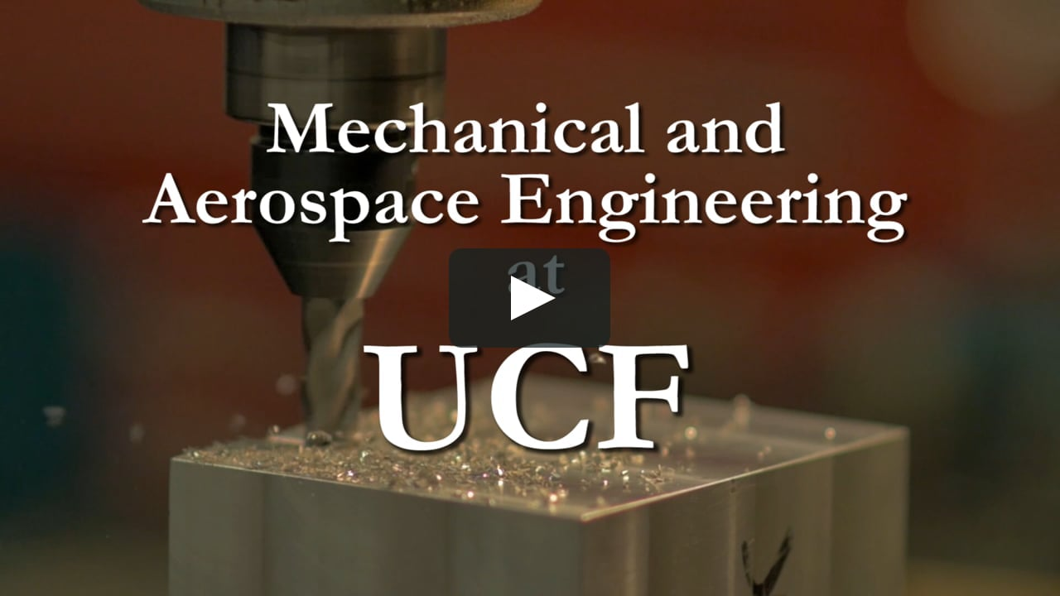
Research prominence —graduate courses
The large undergraduate program took a significant toll on the graduate course portfolio
Expand the graduate course portfolio
  Increase the number of courses to 20-25 from about 16
  More and more frequent courses in
    Aerospace
    Bio-medical engineering

Slide 28
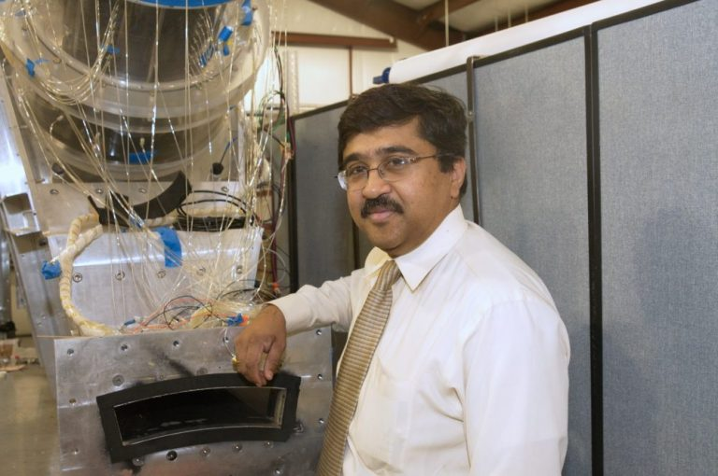
Research prominence — centers of excellence
Research centers/clusters has benefited the department
CATER played an instrumental role in the success of MAE’s research endeavor
  Don’t mess up with success
  We will continue to be committed to support and help the center grow to the best of its ability
Clusters
  Attempt to hire more faculty members
    Biionix
    DAT
  Help the cluster develop and pursue a plethora of collaborative projects to become a hub for the bio-medical and mechanical engineering faculty members in the department

Slide 29
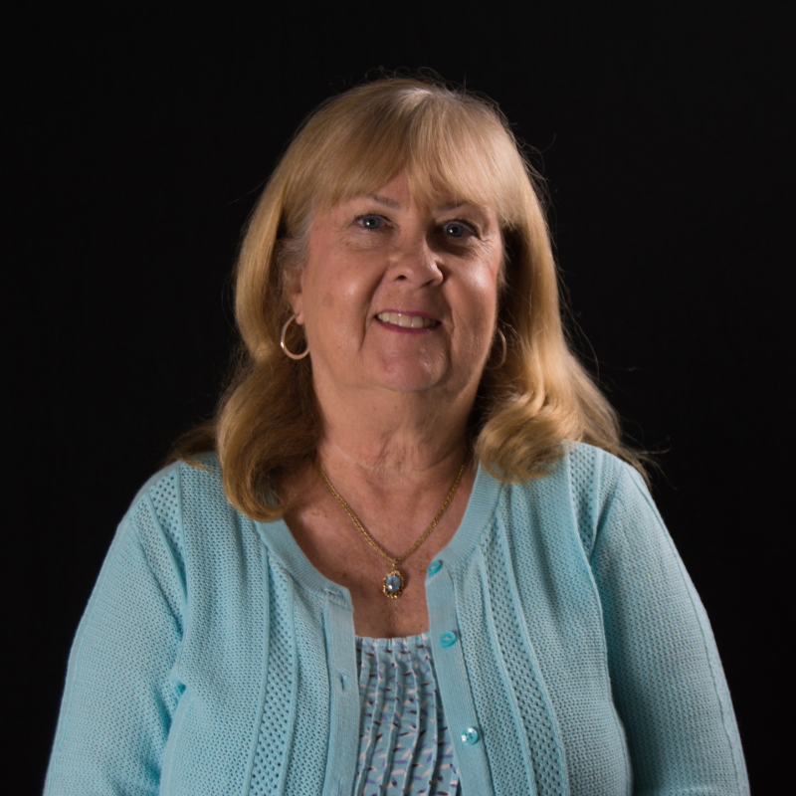
Research prominence —faculty hires and staff retention
MAE will hire several additional Lecturers to help alleviate the undergraduate/graduate program demand
  Replacement hires
  Additional lines?
MAE will hire a couple of additional tenure-track faculty members, potentially through the cluster hires
The health and growth of the MAE is critically dependent on the competency and motivation of faculty and staff members
  Morale
  Sense of belonging and appreciation
  Accommodation for staff specific needs
  advocate for them to the college and university

Slide 30
Mentorship and support of junior faculty members
The success of the junior faculty members will determine the future of this department
Reduced teaching load to tenure-track faculty members throughout their tenure process
Professional development workgroups
Office of Research Fellowships
Department chair will conduct biannual one-on-one meetings
The chair’s open-door policy will continue in an effort to provide guidance, set expectations, and resolve issues as they emerge

Slide 31
Specific goals
A new bio-medical engineering PhD program
A target graduation rate is set to 30-35 annually — about one student per tenure-earning/tenured faculty member on average annually

Slide 32
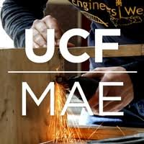
Undergraduate program
Hire several exceptional lecturers
Commitment to the development of leading edge educational content
Continue to leverage more effectively technology in the classroom
Encourage faculty to engage in engineering education initiatives
Expand Honors courses portfolio

Slide 33
Undergraduate — adaptive learning
The department, UCF’s Center for Distributed Learning (CDL) will attempt to develop adaptive learning models on a large scale
A portfolio of mechanical and aerospace engineering courses will be developed based on these models
Faculty members together with the CDL will collectively develop adaptive learning modules for foundation courses (e.g. dynamics, Thermodynamics, etc.)
Research about the educational effectiveness of this effort will be carried out together with CDL’s staff and MAE faculty

Slide 34
Undergraduate — Interdisciplinary (I) design program
Aligning curriculum across department will continue
In the coming years this effort will continue and will result in a unified college-wide program
Funds for industry-sponsored projects will continue to increase with a target annual support of $500k to $1M
The program will be self-sufficient

Slide 35
Undergraduate
Mixed mode course offering in the majority of foundation courses and beyond;
Continue to use technology to improve online content to better serve undergraduate and graduate students.
Offer 10-12 Honors courses annually to expand the personalized teaching environment within a very large undergraduate program
Project based learning models will be emphasized in these sections

Slide 36

Questions?

Slide 37

Mixed mode courses — 2019/2020
F19
S20
F20
S21
EGN 3321: Dynamics
EGN 3343: Thermodynamics –
EML 3701: Fluid Mechanics I
EML 4142: Heat Transfer I
EML 4703: Fluid Mechanics II
EGN 3321: Dynamics
EGN 3343: Thermodynamics
EML 4142: Heat Transfer I
BME 3211: Bio-Mechanics
EGM 3601: Solid Mechanics
Dynamics (2 sections)
EGN 3343: Thermodynamics (2 sections)
EML 3262: Kinematics of Mechanisms
EML 3701: Fluid Mechanics I
EML 4142: Heat Transfer I
EML 4143: Heat Transfer II
EML 4313: Intermediate Dynamics and Controls
EML 4703: Fluid Mechanics II
EGM 3601: Solid Mechanics
EGN 3321: (2 sections)
EGN 3343: Thermodynamics (2 sections)
EML 3101: Thermodynamics of Mechanical Systems
EML 3701: Fluid Mechanics I
EML 4142: Heat Transfer I
EAS 3101 - Fundamentals of Aerodynamics
Total: 5 sections
Total: 3 sections
Total: 12 sections
Total: 9 sections

Slide 38


Chair’s responsibilities
Work with stake holders to set the tone, expectations, and culture
First and foremost to serve the faculty, staff members, and students
Enable faculty and staff to take initiatives to support the department and college
Advocate
  to stakeholders
  its programs
Represent the administration
Provide a forum for everyone to be heard
  Faculty meetings/retreats
  Open-door policy
Build consensus
Provide a vision

